Slide 1
Second Chance Companion Program
Le wagon Pitch
By katrina ariola

Slide 2
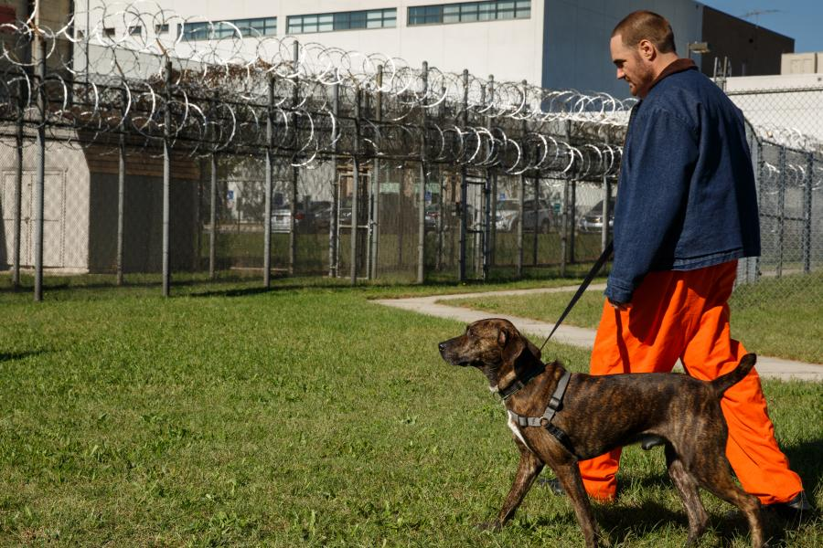
Background
Not-for-profit endeavor started in Pennsylvania, USA
Second Change Companion Dog Program
Explosion in the population in correctional system in United States
More than 2.2 million adults at a cost of ~ $50 billion per year
High rate of recidivism as a major cause of growth
Rampant growth in numbers of abandoned and homeless dogs
Overcrowded and poorly funded shelters find themselves forced to euthanize thousands of dogs annually
Behavioral issues makes them unadoptable due to: poor socialization skills, lack of obedience training and/or neglect in early years
Goal:
reduce recidivism among parolees
Improve conditions in the prison environment
Enhance the adoptability of dogs

Slide 3
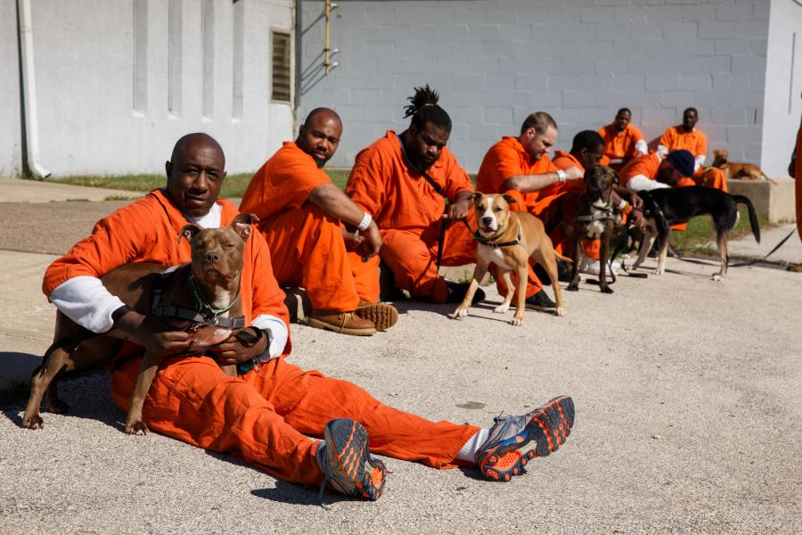
Pain
Limited access to all potential
inmate candidates
Adoptable dogs
Real time access
Progress
Visual contents to entice prospective volunteers, sponsors
Benefits available through the program

Slide 4
Target
District Attorney Offices
Correctional institutions
Shelter Homes
Adoption Agencies
Prospective Trainers
Volunteers
Sponsoring Businesses

Slide 5
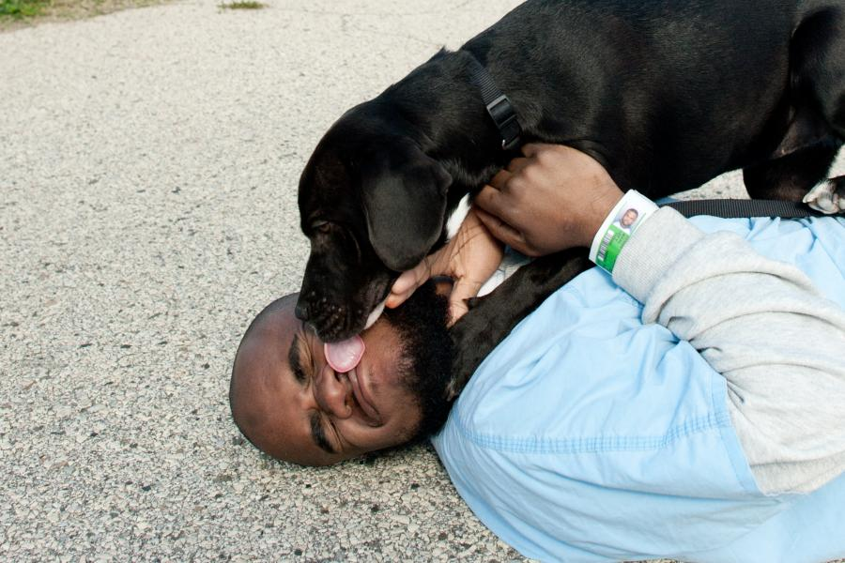
Solution
Centralized database accessible nationwide/worldwide:
Easy query to find qualified inmate candidates and dogs
Readily available analysis of program progress anywhere anytime
Enhanced web based access
Training Sessions
Medium to post or retrieve program functions
Mobile accessibility

Slide 6
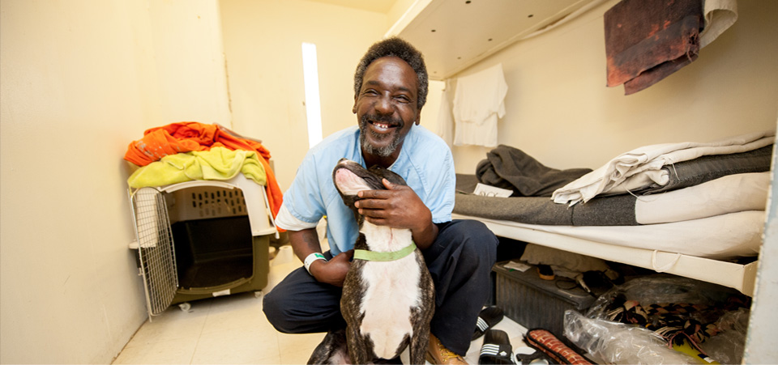
Thank you!

